Slide 1
Input and Output Devices
Instructor: Saba Iqbal

Slide 2
Input and Output Devices
Provide means of communication between a computer and outer world
Also known as peripheral devices
The hardware components that allow the user to input data and instructions into computer and to receive the processed data.
The data and instructions are given to the computer through input devices.
The computer processes the data according to the given instructions and output is received on the output devices or it is stored permanently on the storage device.

Slide 3
Input and Output Devices
Various types of input/output devices are available.
These devices are used for different types of applications.
The I/O devices are slower as compared to the speed of CPU and primary storage.
It is because the speed of I/O devices depends upon the mechanical movement of the components of the devices.
It is impossible that the I/O devices and the CPU and primary storage have the same speed.

Slide 4
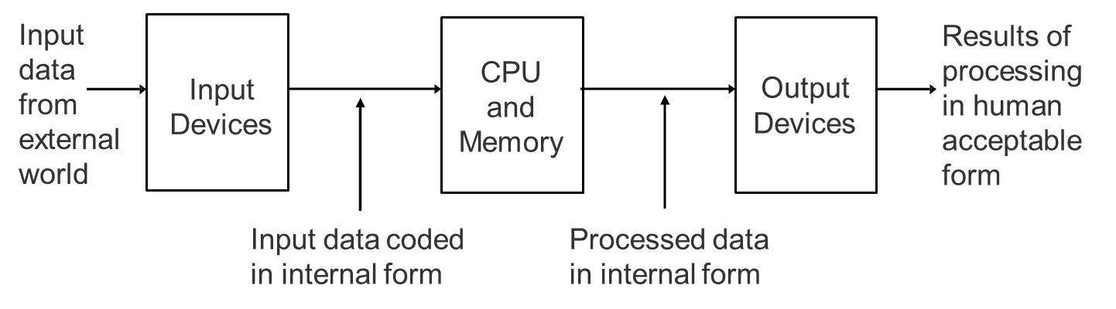
Role of I/O Devices

Slide 5
Input and Input Devices
Anything given to the computer is called input.
The data and instructions are given to the computer as input
The input into the computer can be entered
Through keyboard
By selecting icons on the screen using mouse
By pressing finger on touch screen
By speaking into a microphone
By sending image through digital camera
By scanning data printed on paper through scanner etc.

Slide 6
Input and Input Devices
The devices that are used to enter data and instructions into the computer are called input devices.
The input devices are hardware component. It takes input (data or instructions) from user and converts it into a form that is understandable by the computer.

Slide 7
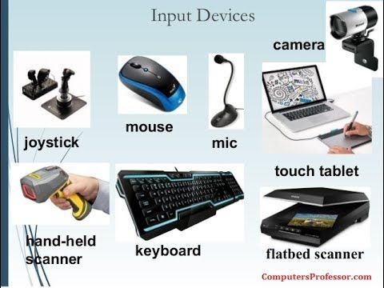
Input Devices
Keyboard
Point & Draw devices
Mouse, Trackball, Joystick, light pen,
and touch screen
Data Scanning Devices
Image Scanner, OCR, Barcode reader, MICR
Digitizer
Used to pictures, maps etc to digital form
Speech Recognition system

Slide 8
Keyboard
Keyboards are the most common type of input device.
Before keyboards, interaction with computers was generally carried out using punch cards and paper tape.
By pressing the relevant keys, a user can feed data and instructions to the computer.
Keyboard looks like a typewriter keypad. But a computer keyboard has some special keys used to perform special functions.
The buttons on keyboard are called keys.
The keyboard contains keys for all alphabetic characters, numeric digits, and special characters.
It also contains some special keys known as function keys.
Notes:
Punched Cards
A punched card is a piece of stiff paper that holds digital data represented by the presence or absence of holes in predefined positions.

Slide 9
Keyboard
A standard keyboard used in personal computers contains more than 100-keys.
The standard keyboard is also referred to as QWERTY keyboard.
Some old type computers have built-in keyboards. Nowadays, the computer has separate keyboard. It is easily plugged into a computer. A keyboard is connected to the serial or USB port on the system unit.
Some advanced keyboards do not require the cable to connect with the computer.
They enter data into the computer through wireless technology such as radio waves or infra-red light waves.
These types of keyboards are known as Cordless or Wireless keyboards.

Slide 10
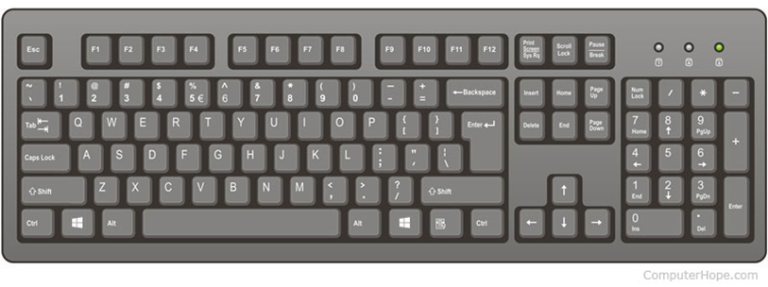
Keyboard

Slide 11
Pointing & draw devices
Pointing device means that is used to control a pointer on the screen.
A pointer represents a small symbol on the screen.
It usually appears on the screen in Graphical User Interface (GUI). For example arrow appears on the screen.
Usually, the pointing device is used;
To select items on the screen
To select commands from command menu
To draw graphs etc.
The Mouse, Joystick, Trackball, Trackpad, Light Pen etc. are examples of pointing devices.

Slide 12
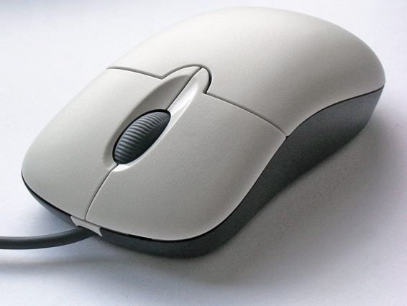
Mouse
A mouse is a pointing input device.
A mouse interacts with a computer through a process known as "point and click."
It controls a cursor in a GUI(graphical user interface) and can move and select text, icons, files and folders on your computer.
There are various types of mouse but most commonly are
Mechanical Mouse
Optical mouse
Cordless Mouse

Slide 13
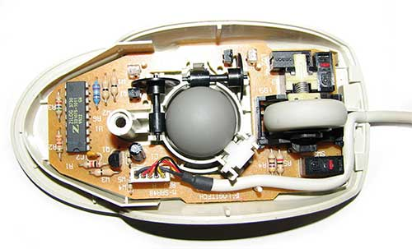
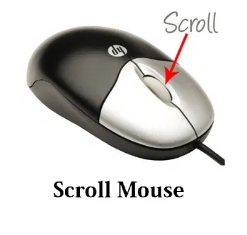
Types of Mouse
Mechanical Mouse
It has a rubber or metal ball at its bottom and an electronic circuit containing sensors. When the pointer roll over the surface, the pointers moves in the same direction on the screen.
The sensor directs the direction of movement of ball and electronic circuit translates the movement of the mouse into signals.
These signals are fed into the computer.

Slide 14
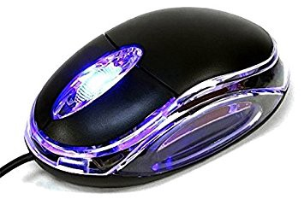
Types of Mouse
Optical Mouse
It has advanced features and is more expensive than mechanical mouse.
It has no ball inside it.
It uses the laser technology to detect the mouse movement by optical sensors.
Now a days commonly used in personal computers.

Slide 15
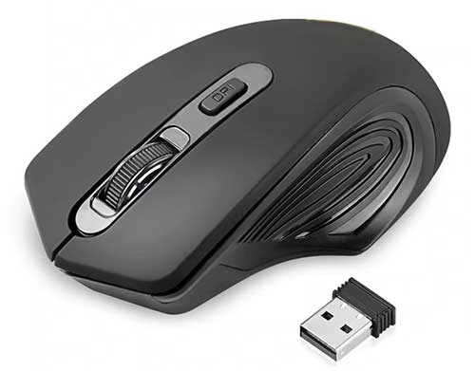
Types of Mouse
Cordless Mouse
Cordless or wireless mouse is not directly connected with computer.
It uses the wireless technology, such as radio waves, or infrared light waves.
It enters input signals into the computer in similar way as cordless keyboard.

Slide 16
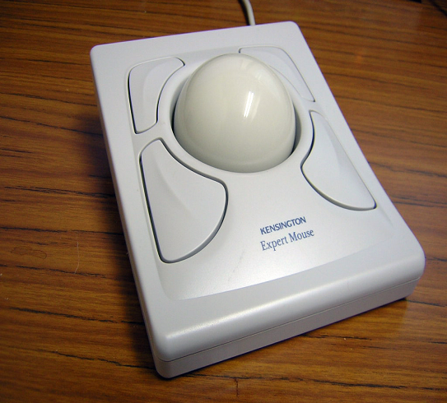
Trackball
It is also a pointing device
Used to enter motion data into computers or other electronic devices
Moveable ball on the top
Instead of moving the whole device, you simply roll the moveable ball on top of the trackball unit with your hand to generate motion input.

Slide 17
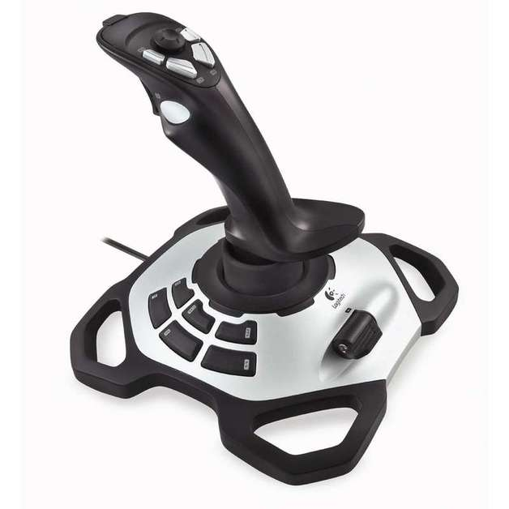
Joystick
A joystick is an input device consisting of a stick that pivots on a base and reports its angle or direction to the device it is controlling.
Joysticks are often used to control video games, and usually have one or more push-buttons whose state can also be read by the computer.
Commonly used for video games, flight simulators, training simulators, and for controlling industrial robots

Slide 18
Data Scanning Devices
Input devices that enable direct data entry into a computer system from source documents
Due to reduced human effort in data entry, they improve data accuracy and also increase the timeliness of the information processed
Demand high quality of input documents
Some data scanning devices are also capable of recognizing marks or characters

Slide 19
Data Scanning Devices Examples
Image Scanner
It uses optical technology to transfer images (or sometimes text) into a computer, where the signal is converted into a digital image.
The digital image can then be viewed on a monitor screen, saved, edited, emailed, or printed.
OCR (Optical Character Recognition)
OCR is the electronic or mechanical conversion of images of typed, handwritten or printed text into machine-encoded text (digital code).
It uses light source to read the characters printed on the paper.
The characters written on paper may be typewritten or handwritten

Slide 20
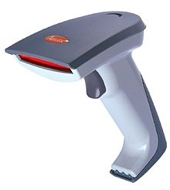
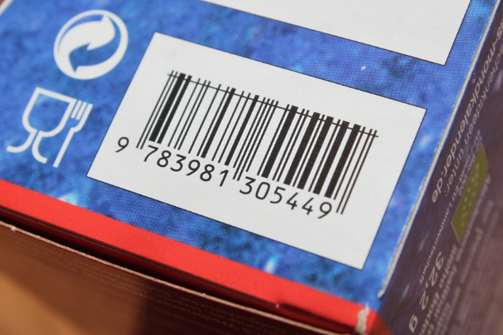
Barcode Reader
A barcode reader (or barcode scanner) is an optical scanner that can read printed barcodes , decode the data contained in the barcode and send the data to a computer
For example, it is used to represent the product information, product name, price or other description.

Slide 21
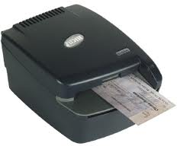
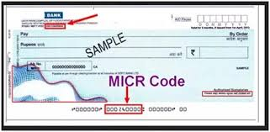
MICR (Magnetic Ink Character Recognition)
It is a special character recognition system that uses special ink and characters.
It reads the characters printed with magnetic ink on paper (or any product) and converts them into digital signals. These signals are then sent to the computer as input for further processing.
When a document that contains this ink needs to be read, it passes through a machine, which magnetizes the ink and then translates the magnetic information into characters.
MICR technology is used by banks.

Slide 22
MICR Character Set (E13B Font)
It consists of numerals 0 to 9 and four special characters
MICR is not adopted by other industries because it supports only 14 symbols

Slide 23
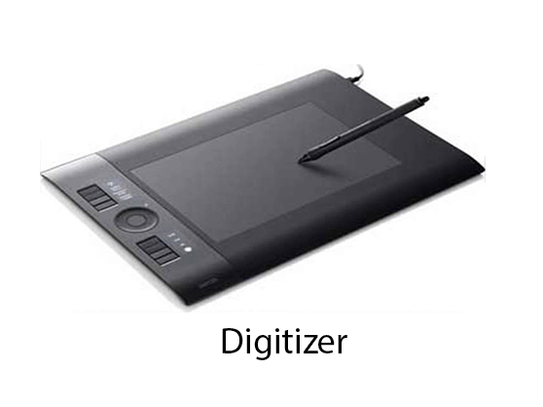
Digitizer
Input device used for converting (digitizing) pictures, maps and drawings into digital form for storage in computers
Commonly used in the area of Computer Aided Design (CAD) by architects and engineers to design cars, buildings medical devices, robots, mechanical parts, etc.
Used in the area of Geographical Information System (GIS) for digitizing maps available in paper form
A digitizer is also known as graphics tablet.

Slide 24
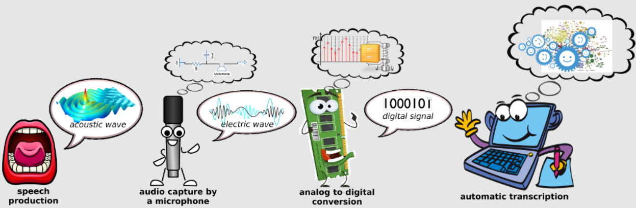
Speech Recognition Devices
Input device that allows a person to input data to a computer system by speaking to it
Today’s speech recognition systems are limited to accepting few words within a relatively small domain and can be used to enter only limited kinds and quantities of data

Slide 25
Types of Speech Recognition Systems
Single word recognition systems can recognize only a single spoken words, such as YES, NO, MOVE, STOP, at a time. Speaker-independent (means a system trained to respond to a word regardless of who speaks) systems are mostly of this type
Continuous speech recognition systems can recognize spoken sentences, such as MOVE TO THE NEXT BLOCK. Such systems are normally speaker- dependent (trained by the individual who use the system)

Slide 26
Uses of Speech Recognition Systems
For inputting data to a computer system by a person in situations where his/her hands are busy, or his/her eyes must be fixed on a measuring instrument or some other object
For data input by dictation of long text or passage for later editing and review
For authentication of a user by a computer system based on voice input
For limited use of computers by individuals with physical disabilities

Slide 27
Output Devices
A hardware component which is used to receive the output from computer is called an output device.
It takes information from computer and converts it in a form that is understandable by the users.
A list of commonly used output devices are:
Monitors
Printers
Plotters
Screen Image Projector

Slide 28
Types of Output
Soft-copy output
Not produced on a paper or some material that can be touched and carried for being shown to others
Temporary in nature and vanish after use
Examples are output displayed on a terminal screen or spoken out by a voice response system
Hard-copy output
Produced on a paper or some material that can be touched and carried for being shown to others
Permanent in nature and can be kept in paper files or can be looked at a later time when the person is not using the computer
Examples are output produced by printers or plotters on paper

Slide 29
Output Devices
Monitors
Monitors are the most popular output devices used for producing soft-copy output
The output may be in the form of text, graphics and video.
It forms images from tiny dots, called pixels that are arranged in a rectangular form.
The sharpness of the image depends upon the number of pixels.
A monitor is also known as a display screen or a visual display unit (VDU).

Slide 30
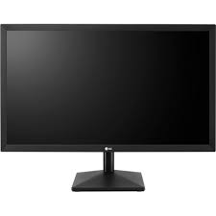
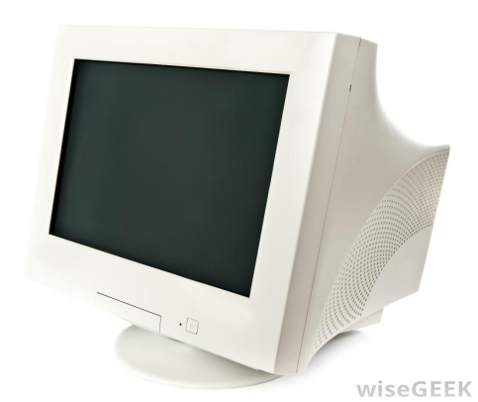
Output Devices
Types of Monitors
CRT (Cathode-Ray Tube) monitors
Flat Panel monitors

Slide 31
Output Devices
CRT (Cathode-Ray Tube) monitors
CRT monitors are most common type of display screen
CRT is the technology used in traditional computer monitors and televisions.
The image on a CRT display is created by firing electrons from the back of the tube to phosphors located towards the front of the display.
Once the electrons hit the phosphors, they light up and are projected on the screen.
The color you see on the screen is produced by a blend of red, blue, and green light, often referred to as RGB.
The screen is organized into a grid of tiny dots of phosphor material. These dots are called pixels

Slide 32
Output Devices
Flat Panel monitors
Flat-panel displays are used in portable computers.
They are much thinner, weightless, and consume less power than CRT.
They are also more expensive than CRT monitor.
It is made up of two plates of glass. These plates contain a substance in between them.
This substance is activated in different ways.
It is available in different sizes.
Most commonly used in mobile devices such as laptops, tablet PCs, PDA (Personal digital assistant) and mobile phones.
Today, flat panel monitors are also used with personal computers.

Slide 33
Output Devices
Flat Panel monitors
Two types of technologies are used in Flat Panel Display Screens like;
Liquid-crystal display (LCD)
Gas-Plasma Display

Slide 34
Output Devices
Printers
These are most commonly used output devices used to get prints of documents on the paper
The output produced by a printer is often called a hard copy
Different printers have different printing mechanisms.
Therefore, printers are classified into two main categories depending upon their printing mechanism.
Impact printers
Non-Impact printers

Slide 35
Impact Printers
It is a type of printer that works by striking the direct contact of an ink ribbon with paper.
These printers are typically loud but remain in use today because of their unique ability to function with multipart forms.
An impact printer has mechanisms resembling those of a typewriter.
Types of Impact Printers are
Dot-matrix printers
Daisy-wheel printers
line printers.

Slide 36
Non-Impact Printers
It is a type of printer that works without striking the paper.
These printers are faster and produce high quality output than impact printers.
They use electrostatic, inkjet and thermal technologies for printing
Types of Non-Impact Printers are
Laser Printers
Ink-Jet Printers
Thermal Printers

Slide 37
Output Devices
Plotters
A plotter is a computer hardware device much like a printer that is used for printing vector graphics, printing architectural drawing, graphs and charts etc.
Instead of toner, plotters use a pen, pencil, marker, or another writing tool to draw multiple, continuous lines onto paper rather than a series of dots like a traditional printer.
It generate high-precision, hard-copy graphic output of widely varying sizes
There are two main types of plotters – drum and flatbed plotters.

Slide 38
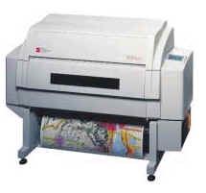
Types of Plotters
Drum Plotter
Drum plotter, is also known as roller plotter.
It consists of a drum or roller on which a paper is placed.
The length of plot size may be very large.
It also consists of mechanical device known as robotic drawing arm that holds a set of pens or pencils.
The drum rotates back and forth to draw (or print) the graph on the paper.
The robotic drawing arm also moves side to side as the paper is rolled back and forth through the roller.
It is used to produce continuous output such as to record earthquake readings.

Slide 39
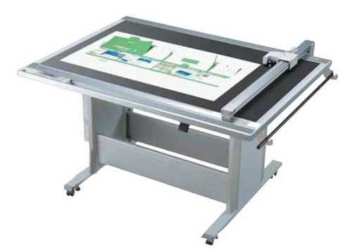
Types of Plotters
Flatbed Plotter
Flatbed plotter, is also known as table plotter
It plots on paper that is lying flat on a table like surface.
Typically, the plot size is equal to the area of a bed and varies according to requirement.
It uses two robotic drawing arms, each of which holds a set of pens.
Most of the flatbed plotters have one to four pens of different colors that move across the paper to draw charts or graphs on the paper.
The movement of these pens is controlled by the computer system.
Flatbed plotters are used in the design of cars, ships, aircrafts, buildings, highways, etc.
It is slower in printing as large and complicated drawings take several hours to print.

Slide 40
Lecture End

